Slide 1
Using a GA to Learn a MCFG
Artyom Skrobov

Slide 2
Languages beyond CFG:
cross-serial dependencies
copy language {ww | w∈{a, b}⁺}
powers language a^{n}b^{n}c^{n}
Dutch and Swiss German:
… | das | mer | d’chind | em Hans | es huus | lönd | hälfe | aastriiche
 | that | we | the children-acc | Hans-dat | the house-acc | let | help | paint
‘... that we let the children help Hans paint the house’

Slide 3
Multiple Context-Free Grammar:
predicates of a fixed dimension
S(XY) | ← P(X, Y)
P(a, a) | ← ε
P(b, b) | ← ε
P(XY, ZW) | ← P(X, Z), P(Y, W)
G_{copy}
Linearity: each input substring used exactly once *[Fred [took a picture]_{VP} of you]_{S}, and [Susan of me]_{S}
Grammar dimension: max over N; 1 for CFG
Grammar rank: longest concatenation
O(n^{d·(r+1)}) parsing for dimension d and rank r

Slide 4
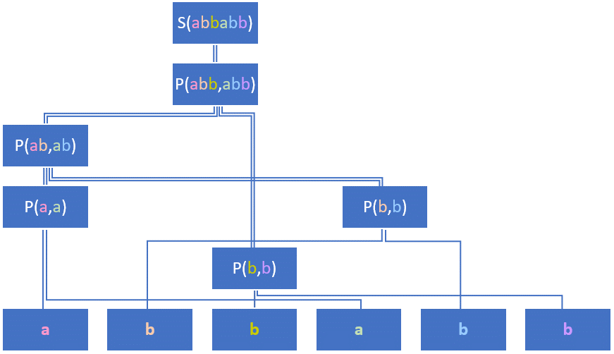
MCFG parse tree:
abbabb with G_{copy}

Slide 5
MDL score:
|G|
SXY#PXY##
Pa$a##
Pb$b##
PXY$ZW#PXZ#PYW##
N¹ (T∪V∪{$})⁺ # (N¹ V⁺ #)⁺ #
N = {S, P}
T = {a, b}
V = {X, Y, Z, W}
|G_{copy}| = 11·log₂3 + 17·3 + 9·log₂5 ≈ 74.7 bits

Slide 6
MDL score:
|D:G|
S(XY) | ← P(X, Y)
P(a, a) | ← ε
P(b, b) | ← ε
P(XY, ZW) | ← P(X, Z), P(Y, W)
G_{copy}
S → P → PP → aPa → abab
|abab : G_{copy}| = 0 + 3·log₂3 ≈ 4.8 bits
|D| = 2n ⇒ |D:G_{copy}| = (2n−1) log₂3

Slide 7
Baseline concatenation grammar
P(a) | ← ε
P(b) | ← ε
S(XY) | ← P(X), S(Y)
S(X) | ← P(X)
G_{con}
|G_{copy}| = 11·log₂3 + 17·3 + 9·log₂5 ≈ 74.7 bits
|G_{con}| = 11·log₂3 + 9·log₂6 + 6·log₂3 ≈ 50.2 bits
D = {aa, bb, aaaa, abab, baba, bbbb, aaaaaa, aabaab, abaaba, baabaa, abbabb, …}
|D| = 306
|D:G_{copy}| = (306−40) log₂3 ≈ 421.6 bits
|D:G_{con}| = 306·2 = 612 bits

Slide 8
Overfitting grammar
S(aa) | ← ε
S(bb) | ← ε
S(aaaa) | ← ε
S(abab) | ← ε
. . .
|G_{rote}| = 40·2 + (306 + 40)·2 = 772 bits
|D:G_{rote}| = 40·log₂40 ≈ 212.9 bits
D = {aa, bb, aaaa, abab, baba, bbbb, aaaaaa, aabaab, abaaba, baabaa, abbabb, …}
|D| = 306
|D:G_{copy}| = (306−40) log₂3 ≈ 421.6 bits
|D:G_{con}| = 306·2 = 612 bits

Slide 9
Motivation for MDL
 | |G| | |D:G| | MDL score | language
G_{copy} | 74.7 | 421.6 | 496.3 | {ww | w∈{a, b}⁺}
G_{con} | 50.2 | 612.0 | 662.2 | {a, b}⁺
G_{rote} | 772.0 | 212.9 | 984.9 | D

Slide 10
Genetic Algorithm:
implementation
10,000 iterations, starting from G_{con}
10 islands of up to 200 grammars each
Round-robin migration every 100 iterations
Mutations and optional crossover
Penalty of 35 bits per non-parsable word
Penalty (|G_{original}|−|G_{stripped}|)/100 for non-reachable rules and NTs
Parser allows terminals only in N(t)←ε
Natural for NLP
Parser allows unused variables
S(X) ← P(X), R(Y)
S(X) ← P(X, Y)
r>4 disallowed for performance reasons

Slide 11
Genetic Algorithm:
mutations
Add a new terminating rule for an existing or a new NT
Add an aliasing rule between two NTs of the same dimension
Add a concatenating rule with two unary NTs on the RHS
Delete a random rule
Expand a unary NT using a random production rule
Add a random NT on the RHS, ignore its predicated variables on the LHS
Delete a NT whose predicated variables are ignored on the LHS
Delete the use of a random variable on the LHS
Concatenate an unused variable in a random position on the LHS
Split a NT, adding a new dimension, e.g. P(XY)←A(X)B(Y), S(X)←P(X) into P(X, Y)←A(X)B(Y), S(XY)←P(X, Y)
Merge two dimensions of a NT (i.e. the inverse of the above)
Swap two dimensions of a multidimensional NT on the LHS
Swap two variables in a concatenation on the LHS
Mutate the terminal symbol in a terminal rule
Mutate a NT symbol on either side of a rule
Any mutation results in a valid MCFG
Every valid MCFG can be reached via a chain of mutations

Slide 12
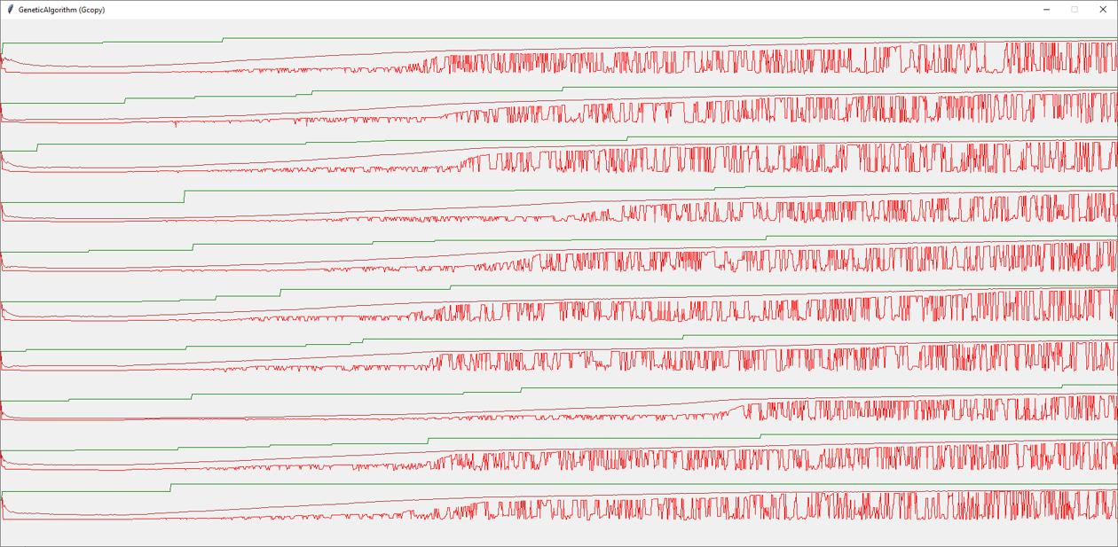
Simulated evolution:
the first 1800×10 generations

Slide 13
Experimental results:
unexpected distractor
 | |G| | |D:G| | |G|+|D:G| | language | |G| + 3×|D:G|
G_{con} | 48.6 | 612.0 | 660.6 | {a, b}⁺ | 1884.6
G_{opt} | 71.1 | 459.0 | 530.1 | {a, b}^{2n} | 1448.1
G_{copy} | 144.3 | 421.6 | 565.9 | {ww | w∈{a, b}⁺} | 1409.1
A → a | b
S → AA | ASA
S → ASA → AASAA → AAAAAA → … → abbabb
|D| = 2n ⇒ |D:G_{opt}| = 3n

Slide 14
Experimental results:
optimized distractor
 | |G| | |D:G| | |G|+|D:G| | language | |G| + 3×|D:G|
G_{con} | 48.6 | 612.0 | 660.6 | {a, b}⁺ | 1884.6
G_{opt’} | 135.7 | 434.0 | 569.6 | {a, b}^{2n} | 1437.7
G_{copy} | 144.3 | 421.6 | 565.9 | {ww | w∈{a, b}⁺} | 1409.1
A → PP
P → a | b
C → A | AA
S → C | ASA
S → ASA → ACA → AAA → PPPPPP → … → abbabb
|D| = 2 + 4n ⇒ |D:G_{opt’}| = 4 + 5n
|D| = 4 + 4n ⇒ |D:G_{opt’}| = 6 + 5n

Slide 15
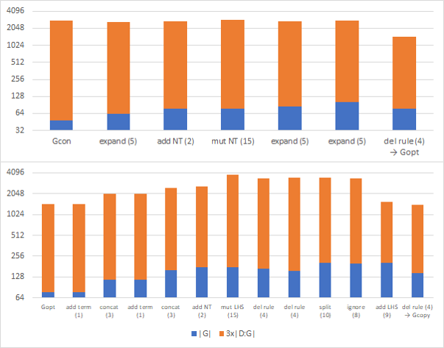
Experimental results:
why wasn’t G_{copy} reached?
G_{con} → G_{opt}:
longest climb is two steps
12% increase in score
G_{opt} → G_{copy}:
longest climb is six steps
×2.7 increase in score

Slide 16
Experimental results:
other corpora
D₂ = {ab, aabb, aaabbb, aaaabbbb, aaaaabbbbb}
D₃ = {abc, aabbcc, aaabbbccc, aaaabbbbcccc}
D_{poly} = {a, b, aa, bb, aaa, aba, bab, bbb, aaaa, abba, baab, bbbb, aabaa, baaab, abbba, abaaba, abbabba, abbaabba, abababa, aabaaabaa, babab, babbab, abaaaba, aaabaaa, aabbbaa, abbbba, babbbbab}
The target CFG for a^{n}b^{n} was successfully found.
The target MCFG was not found, but the GA achieved even better score!
The target CFG was not found; the result G_{opt’’} has much worse score.

Slide 17
Grammars for a^{n}b^{n}c^{n}
A(a) | ← ε
B(b) | ← ε
C(c) | ← ε
P(X, Y, Z) | ← A(X), B(Y), C(Z)
P(XU, YV, ZW) | ← A(X), B(Y), C(Z), P(U, V, W)
S(XYZ) | ← P(X, Y, Z)
|G|=192.9, |D:G|=10, |G|+3×|D:G|=222.9
 | A → a
 | B → b
 | C → c
 | P → BP | C
 | S → ASP | b
a^{n}b(b∗c)^{n}
|G|=100.5, |D:G|=30, |G|+3×|D:G|=190.5

Slide 18
Grammars for palindromes
 | |G| | |D:G| | language | |G| + 3×|D:G|
G_{con} | 48.6 | 264.0 | {a, b}⁺ | 840.6
G_{opt’’} | 106.1 | 233.0 | {a, b}⁺ | 805.1
G_{pal} | 151.8 | 191.3 | {ww↺ | w∈{a, b}⁺} | 725.6
S → PS → PPS → PPPS → → PPPP → … → abba
|D| = n ⇒ |D:G_{con}| = 2n
S → PSP → PCP → PPPP → … → abba
|D| = 1 + 2n ⇒ |D:G_{opt’’}| = 3 + 3n
|D| = 2 + 2n ⇒ |D:G_{opt’’}| = 4 + 3n
A → a | P → a | b
B → b | C → P | PP
S → ASA | BSB | AA | BB | a | b | S → C | PSP
G_{pal} | G_{opt’’}

Slide 19
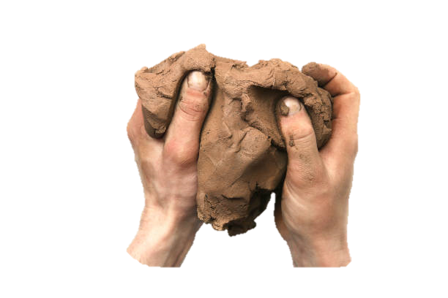

Why so?
For CFG, nearly any encoding is a valid grammar
Mutations can be local
Small mutations may cause small changes to performance
For MCFG, validity depends on non-local constraints
Very few local mutations are possible
Massive mutations cause massive changes to performance
Multidimensionality never lives long enough to come useful
Effectively, searching among CFGs, but with MCFG mutation rules

Slide 20
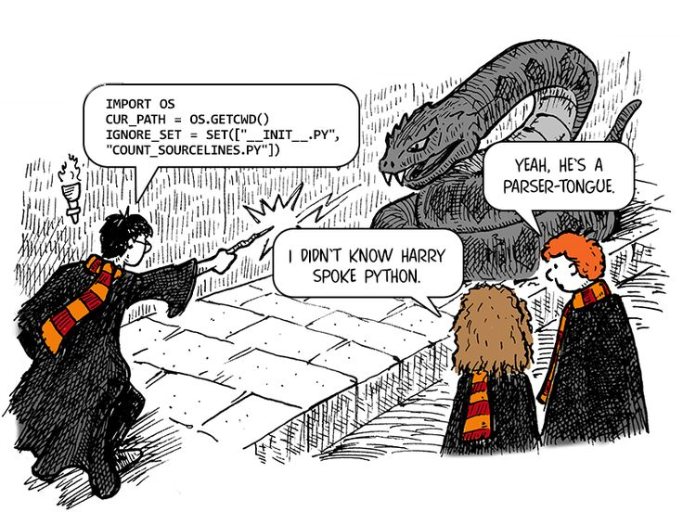
Directions for further work
Try another MCS formalism, with less “rigidity” in representation
Try tweaking meta-parameters for GA
https://github.com/tyomitch/pmcfg

